Slide 1

CPT 05
Department of Computer Science & Engineering
BVBCET

Slide 2
AGENDA
Problem Definition
Scope of the project
Deployment
Functionalities
Requirements and Constraints
Future scope
References

Slide 3
Problem Definition
“To Create A P2P Communication Framework For Android Mobile Platform”
Dept of Computer Science,BVBCET, HUBLI

Slide 4
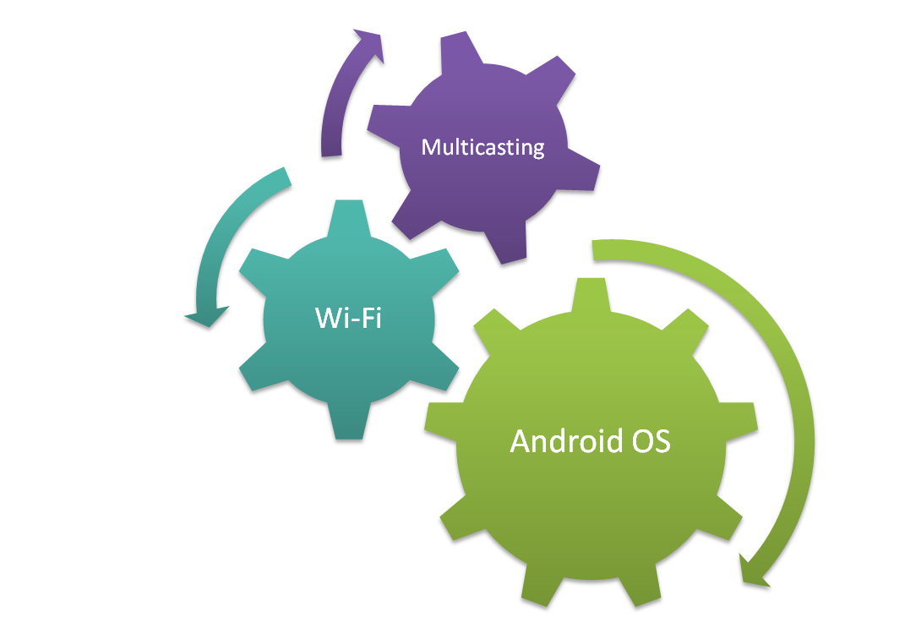


Scope of Project
Content Sharing
Groups
Chatting

Slide 5
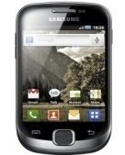


Deployment Diagram

Slide 6
Functionalities

Slide 7
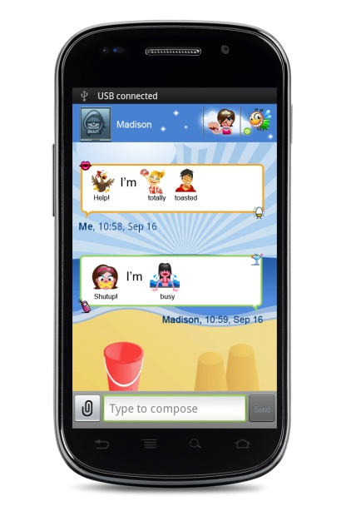


Chatting between two devices

Slide 8



Chatting with multiple devices

Slide 9

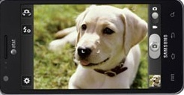

Camera video streaming between single/multiple devices

Slide 10
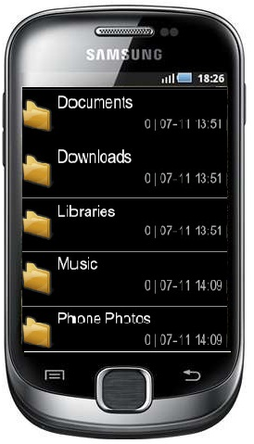
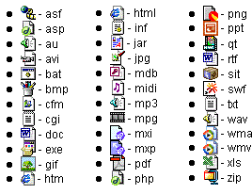

File transfer between single/multiple devices.

Slide 11

Grouping
G2
G3
G1

Slide 12
Requirements and Constraints

Slide 13





Hardware Requirements
Min RAM : mobile - 279 MB
System - 512 MB
System : Desktop / Laptop windows xp + , Mac
Hardware Requirements
Device: Android enabled smart phone : With touchscreen
Modem : WIFI 802.11IEEE Wireless Ethernet

Slide 14




Software Requirements
Software : Android SDK 2.2 (or above)
IDE: Helios Eclipse version 3.6.1
Software Requirements
Operating system : Windows XP (or higher) and Android

Slide 15
Constraints
Only 5 devices in a group
A device can interact with only one group at a time
All devices concerned need to be connected to the same Wi-Fi network

Slide 16
Future Scope
Can be extended to more number of devices in a group
Connect and interact with more than one group at a time
Extend to other mobile OS like iOS, windows

Slide 17
References
[i] Robosoft Technologies Pvt. Ltd, Suggested, (2011 Aug).
[ii] developers.android.com

Slide 18
THANK YOU
Dept of Computer Science,BVBCET, HUBLI

